Slide 1
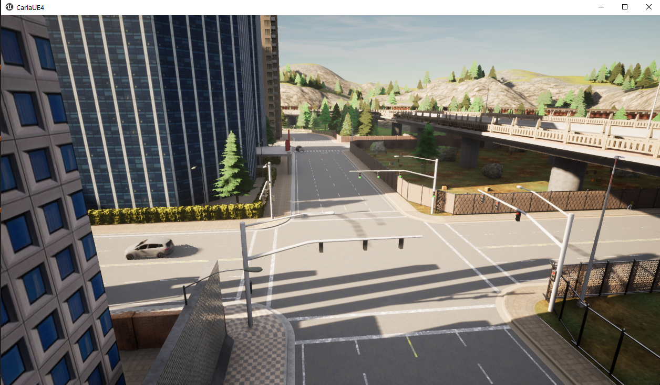
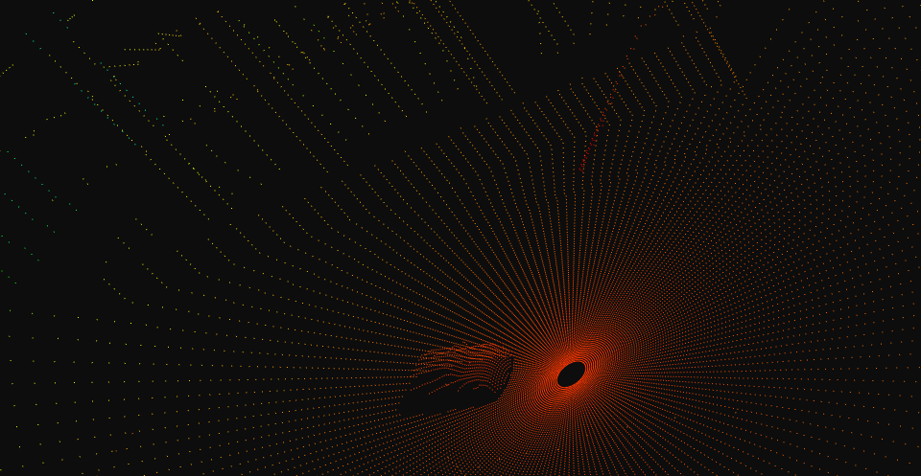
Carla-based simulation
Roadside camera output
Simulation scenario
Roadside lidar output

Slide 2
Simulator
Roadside Cameras
Roadside Lidars
On-vehicle sensors
Images
Point cloud
Image detector
Point cloud detector
Vehicle perception system
Fusion research

